Slide 1

CHAPTER SEVEN

Slide 2

When the patient dies
Note the time of death.
Check if loved ones are ok.
Notify hospice.
At a facility; notify a staff member.

Slide 3


After the patient dies
Offer your condolences
Support and compliment loved ones
If permitted by hospice and loved ones, gently close the patient’s eyes/mouth
Offer loved ones some alone time with the patient’s body
Suggest tactfully that loved ones leave the room when the mortuary comes
Share stories about the patient while waiting for the mortuary
Stay with the loved ones while the mortuary prepares and picks up the body
Remind loved ones of hospice bereavement services being available
At a facility; thank staff members and sign out

Slide 4

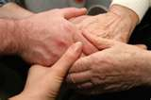




The importance of self-care
Take care of your health:
Mentally
Physically
Emotionally
Spiritually
  Prevent burnout

Slide 5
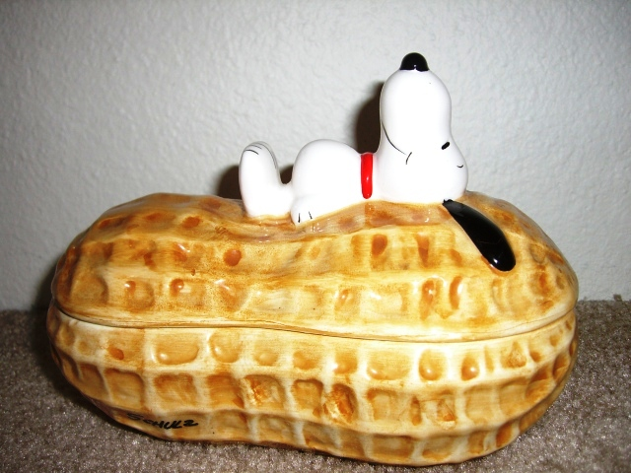

Relax…
Boundaries
Support system
Music
Take a walk…
Write poetry…
Get enough rest!

Slide 6
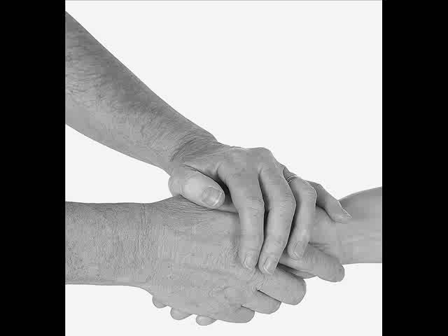
Gentle Pass Times
May you find some comfort here

Slide 7

Gentle Pass Times
Written by:
Francisca Stolzenbach
Music sung by:
Francisca Stolzenbach

