Slide 1

CHAPTER SIX

Slide 2

Things to
AVOID
Never give an estimate of how long the patient may be alive.
No proselytizing in any way.
Do not argue with a patient about time, place or circumstance.
Do not generalize.
Do not judge.
Do not use clichés.

Slide 3
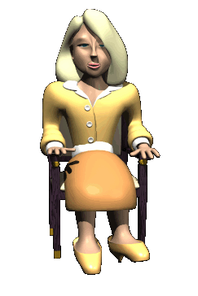
Never move or reposition a patient or fix sheets.
Do not wear too much cologne.
When children are involved, do not use euphemisms.
Never promise complete confidentiality.
No private calls, phone on vibrate or silent.
Do not accept gifts.
Try to avoid “depersonalization”

Slide 4



Other things to keep in mind
Stick to the plan of care!
Respect the patient’s right to privacy and mind HIPAA.
If you suspect a patient is not being treated well,
contact hospice right away.
Do not visit if you carry a communicable disease.

Slide 5



Do
NOT
Call 911

Slide 6


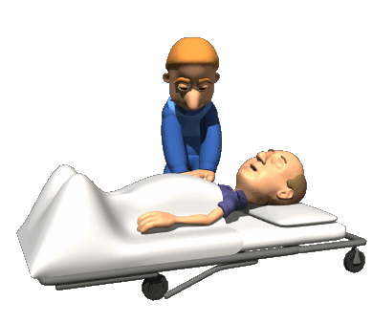



When you call 911….

