Slide 1

CHAPTER FIVE

Slide 2


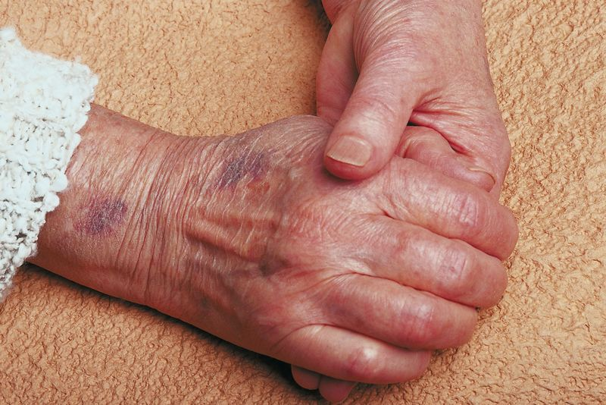
The restless patient
Unfinished business, fear of the unknown
Last hoorah, terminal agitation, near death awareness
Confusion, hallucinations
Alzheimer’s disease
Veterans
PTSD

Slide 3
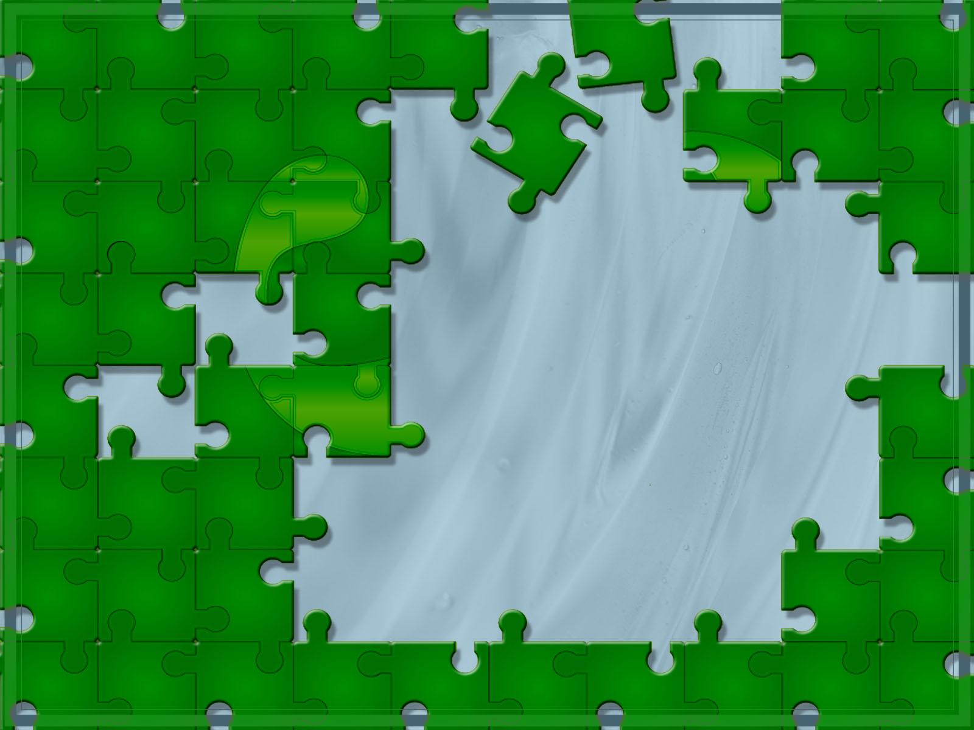
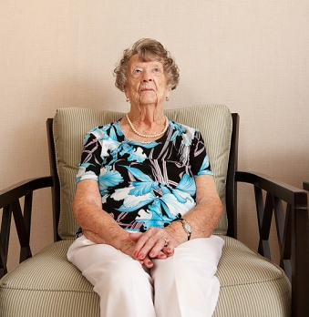
Alzheimer’s patients
Often perceive to be living in the past
May not recognize their loved ones
Do not realize it when they hurt loved ones
Often cannot speak – yet they can sing
May be confused/frightened

Slide 4


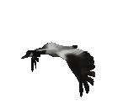
How can you support an Alzheimer’s patient?
Calm demeanor
Reassurance
Kind facial expressions
Lead by example
Short yes/no questions
Physical touch may bring a patient back to the “now”
Start every conversation with the patient’s name

Slide 5
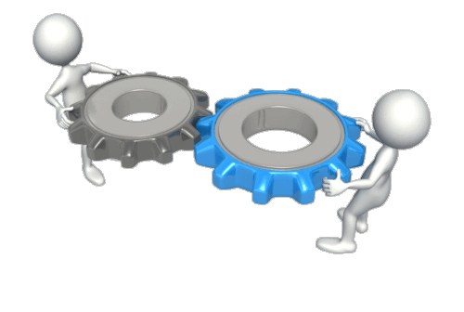
Avoid questions about long term past
Do not argue with the patient about time, place or circumstance
If patient gets agitated – redirect
Allow loved ones to lament
Loved ones often struggle with role reversal
The patient’s decline may be hard on loved ones
If the patient is non verbal, try the ‘singing conversation’ option

Slide 6

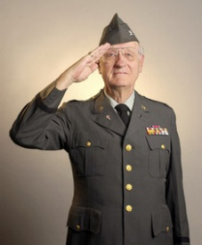
Veterans
Often prefer a fellow veteran
as their volunteer
Often underreport because of
military stoicism
Veterans sometimes have been
sexually assaulted
Sometimes wish to share
about their experiences
Sedation may cause a sense
of loss of control

Slide 7
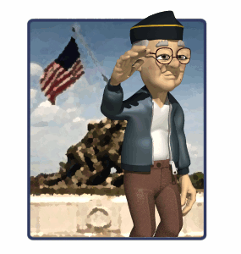
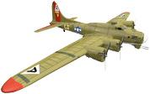
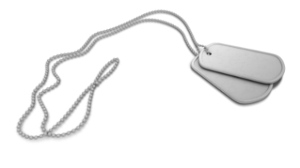
May suffer from PTSD
May suffer from moral injuries
May have “unknown” children
No judgments/assumptions

Slide 8

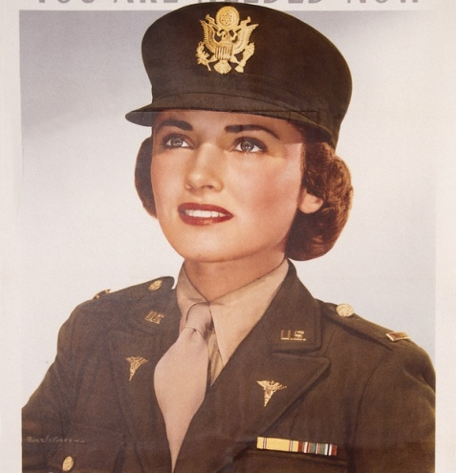
Thank all veterans for serving their country and thank females
for paving the way.
- Acknowledge veterans AND loved ones.

Slide 9
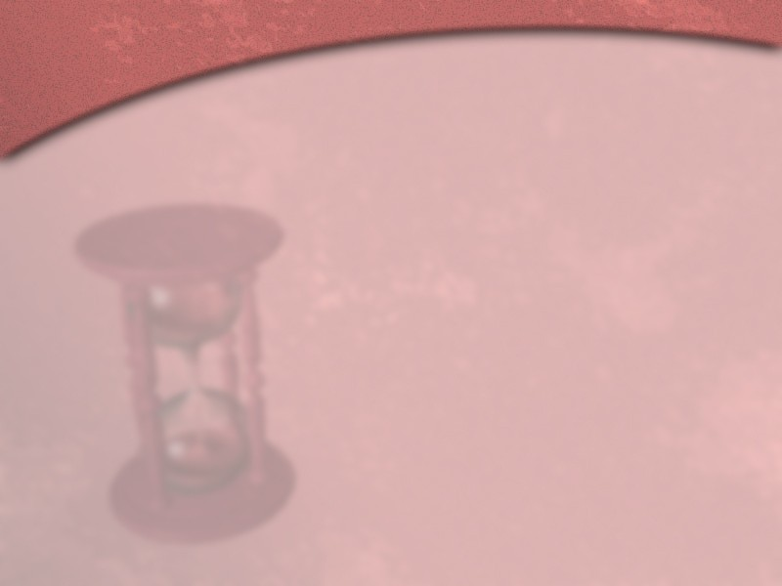

PTSD
Post Traumatic Stress Disorder
Often gets confused with terminal agitation
Develops under extreme, traumatic situations
Often seen in combat veterans
May be acute, chronic or delayed
Therefore often goes undiagnosed

Slide 10
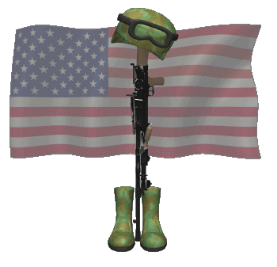
Post Traumatic
Stress Disorder
Can cause severe anxiety
Many different “Triggers” are possible
Patients experiences the exact same emotions as before
Patients often display hyper vigilance
Patients may have paradoxical reactions to certain medications

Slide 11
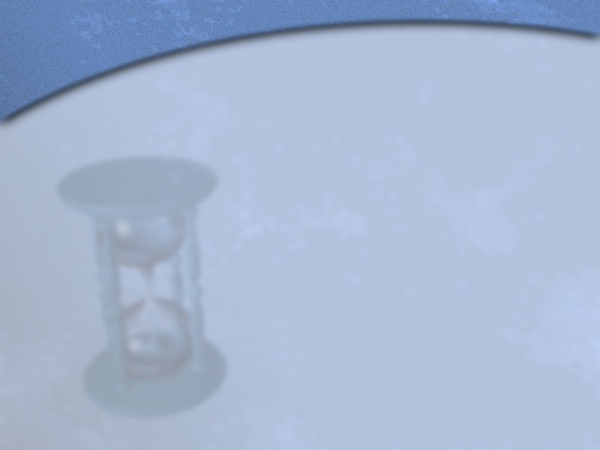
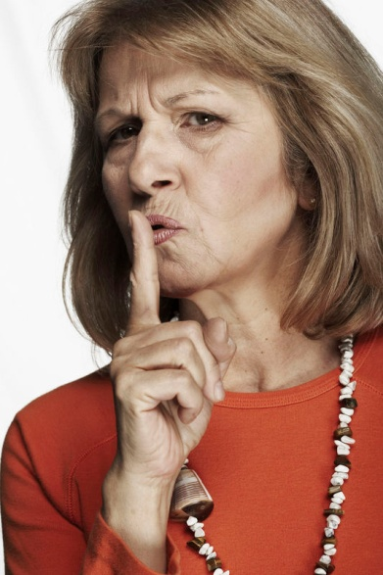
PTSD
No sudden loud noises
Do not touch unexpectedly
Don’t approach from behind
Gentle reassurance, no restraints
Gently guide the patient through the experience

Slide 12

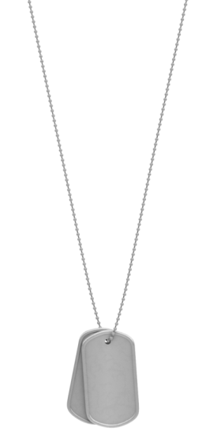
Be tactful, don’t diminish – this is REAL for the patient
Patient often needs a sense of control
Need for a sense of safety; physically AND emotionally
Look for verbal and nonverbal clues
Be creative

Slide 13



Working with people from different cultures
Don’t generalize or make assumptions
Don’t be afraid to ask questions
Embrace our differences
Respect is the key

Slide 14

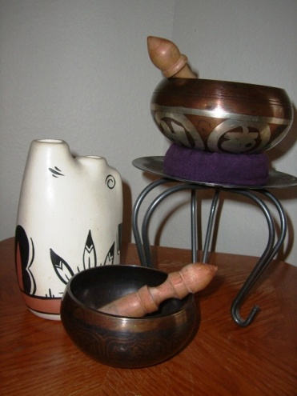
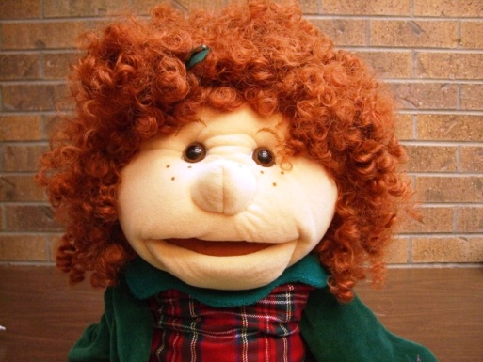
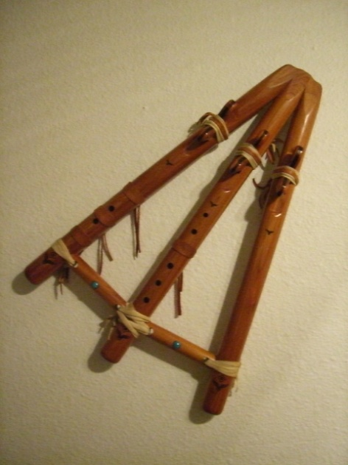
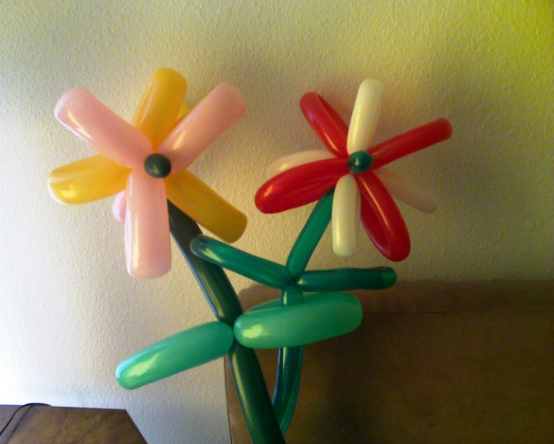

Be
creative!
Think fast!

