Slide 1

CHAPTER FOUR

Slide 2

What can you
do for a patient?
Provide
A calm, comforting atmosphere
Be
WITH a patient not NEAR
Observe
Body language, listen, watch
Acknowledge
This is a difficult time

Slide 3
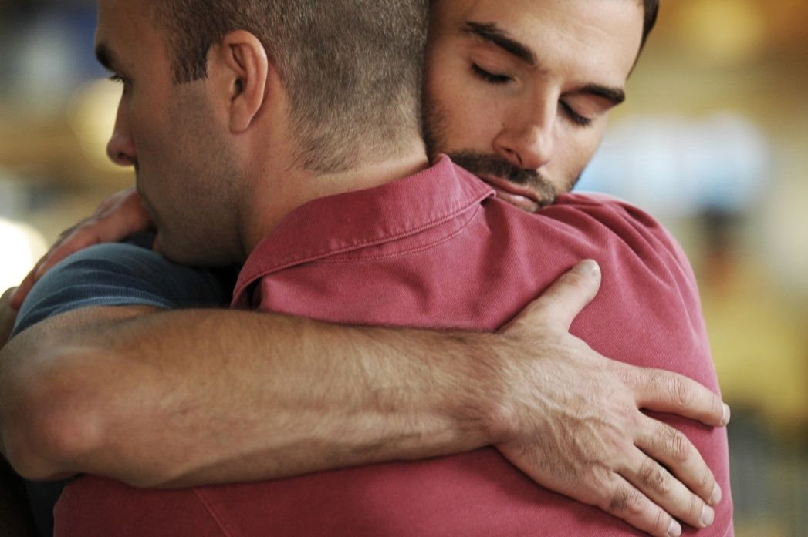
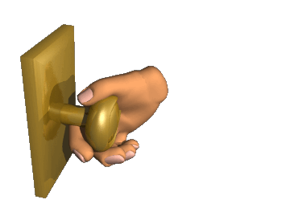
Support
Listen, offer concrete help
Maintain
Patient’s dignity and welfare
Advocate
For the patients needs and wellbeing
Eliminate
Background noises and/or excessive light

Slide 4


Being mindful
Be mindful
Avoid saying things like; “you should or you shouldn’t or just…”
Watch your body language
If someone declines to talk about something, do not push
“Why” questions tend to make people a bit defensive
Do not interrupt the patient
Allow a patient their journey
Understand that you cannot fix everything
Being mindful also means honoring
your own boundaries!

Slide 5





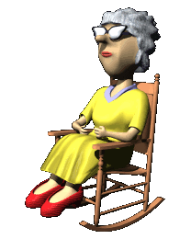
What else can you do?
Sit in silence
Sing to the patient
Read to the patient
Brush the patient's hair
Put lotion on the patient’s hands

Slide 6

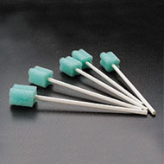
Talk with the patient/to the patient.
If the patient “fidgets” place something in his hands.
Apply a wet washcloth to patient’s forehead if she has fevers.
If the patient has trouble breathing, raise the head of the bed.
Moisten the patient’s lips with a swab.

Slide 7
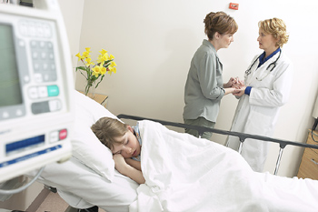
Unresponsive Patients
Deserve the same dignity as anybody else.
Deserve the same respect as anybody else.
Treat them as you would anybody else.
May very well hear everything that is said.
Set and example for loved ones.

Slide 8
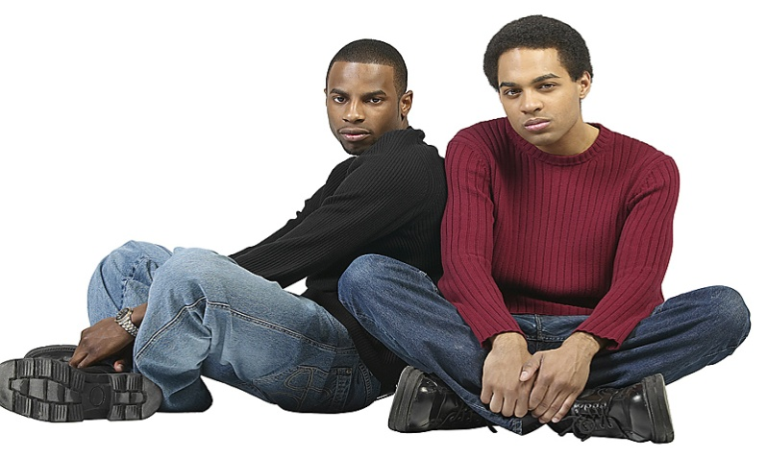
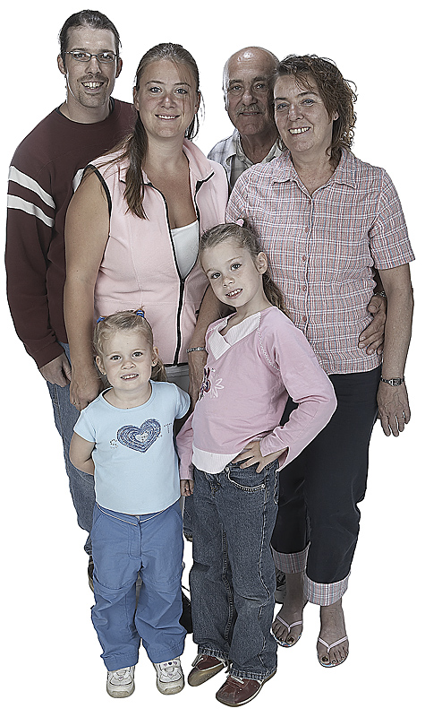
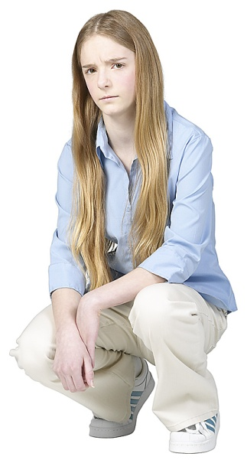

Loved ones come in many shapes and forms and with just as many emotions.
Navigate delicately and observe.
Remind loved ones that hospice support is there for them
as well as the patient.
Try to be patient,
open minded and tactful.
LOVED ONES
When needed, contact hospice for support.

Slide 9


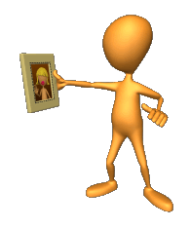








More helpful options
Provide a calm, comforting atmosphere.
Create a gratitude list and/or a “shrine”
Offer loved ones “alone time” with the patient.
Educate loved ones about the dying process and gently guide them through.
Explain, acknowledge and reassure.

Slide 10
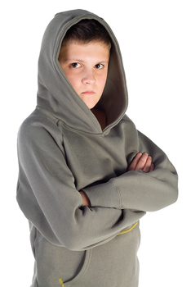

Affirm that people deal with different issues in different ways.
Don’t be afraid to share your own vulnerability.
Offer concrete help.
Allow for silence.
Leave a note when you leave.

Slide 11

When children are involved
CHILDREN:
May be stronger than you think
Deserve age appropriate guidance
Should be granted (never be pushed) a chance to say goodbye
Often feel better when they feel they are helping
May benefit from
one-on-one time
Sometimes blame themselves
May bring love and laughter
May struggle with anticipatory anxiety
May act out

Slide 12

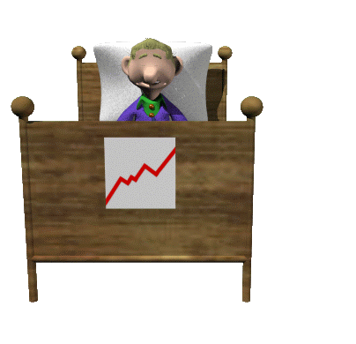

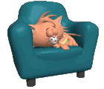
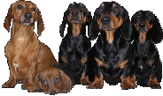
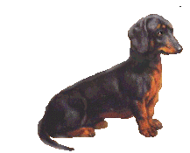


Patients and pets
Pets are aware
Be watchful for “acting out”
May be soothing
May be funny and/or endearing
May be a gauge

