Slide 1

CHAPTER THREE

Slide 2
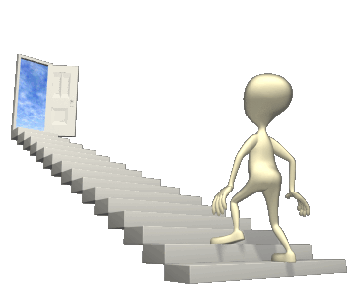


Signs
&
Symptoms
Increased sleeping pattern
Withdrawal, confusion
Decreased appetite/thirst
Decreased ability to swallow
Weight loss
Eyes/vision, jaw, neck, ears
Urine output/incontinence
Swelling
Temperature, blood pressure
Heart rate, seizures, pain
Cheyne-Stokes breathing
Death rattle
Skin changes, mottling
Last hoorah
Terminal agitation
Near death awareness

Slide 3

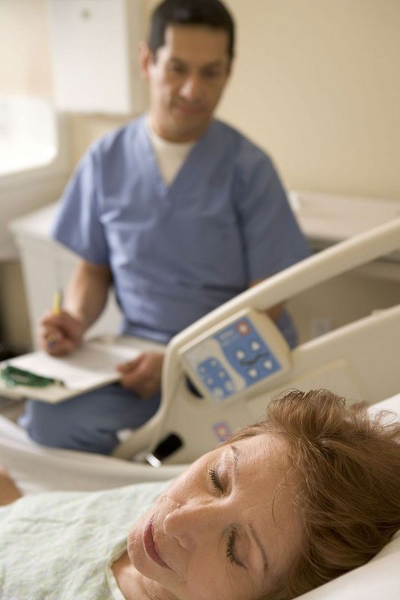
Increased sleeping pattern
The patient may be dying but the body still tries to fight which costs a lot of energy. So keeping on arousing the patient may be counter productive.
Changes in the patient’s metabolism may also cause a patient to sleep more.
Withdrawal
Patients often withdraw from loved ones and/or former passions because they are processing a lot of things such as their own impending death, facing the unknown, losing their independence, worry about loved ones etc.

Slide 4


Confusion about time, place, people and/or circumstance
The patient’s consciousness may fluctuate because of medications and/or depending on where the patient is in the dying process.
(Most people slip into a semi coma/coma before they die.)
Some people believe that patient’s are “checking out the other side”
so to speak, and get confused about where they are.
Some patients may be completely lucid right up until they die.

Slide 5

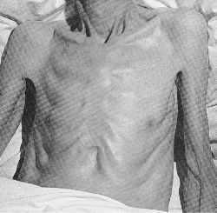
Decreased appetite/thirst
Certain medications and chemotherapy may alter the way food tastes.
Certain medications may cause the patient to feel nauseas.
Trigger for hunger and thirst decreases and eventually disappears.
Cancer cells are more demanding and have a faster metabolism.
A patient should not be forced to eat or drink.
Decreased ability to swallow
A lot more in the last week so the risk for aspiration increases.
Thirst is a sensation of the mouth so ice chips or swabs may help.
Patients with Alzheimer’s disease often completely forget how to swallow.
One of the reasons why nurse administers the patient medication
in the patient’s cheek or under the tongue.
Weight loss
The patient may lose a lot of weight when getting closer to death.

Slide 6

Eyes
Eyelids become more relaxed.
Sometimes only one eye may be open.
Eyes may be closed all the way as well.
May become fixated on a certain spot.
Artificial tears may be helpful.
Body dictates the state of patient’s eyes.
Jaw
Jaw may relax causing the mouth to fall open.
Swabs and/or Chap Stick may benefit the patient’s dry lips.

Slide 7


Extended neck
On occasion the patient’s neck extends fully.
Relaxed earlobes/ear
On occasion the patient’s earlobe or entire ear will relax and lay flat against one’s head.
Hearing is the last of the senses to “go!”

Slide 8

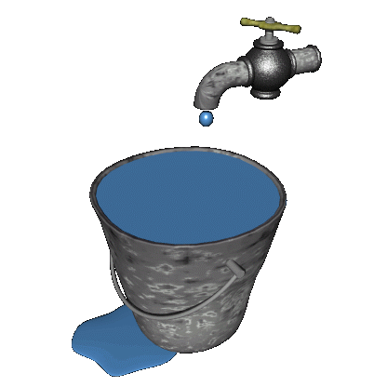
Urine output
As the body shuts down it’s systems, so do the kidneys shut down as well.
As this process progresses, the patient will present with significantly less urine output and the urine will become darker as well because the patient is drinking less which will make the urine more concentrated.
Even though the patient is not eating and/or drinking, the body still produces waste.
Incontinence
Near death and most certainly after death, the patient may become incontinent of urine and/or bowels.
- Keep in mind that this may be a sensitive subject for the patient and/or loved ones.

Slide 9

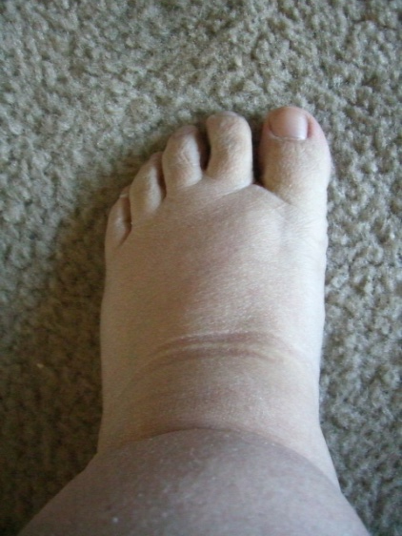
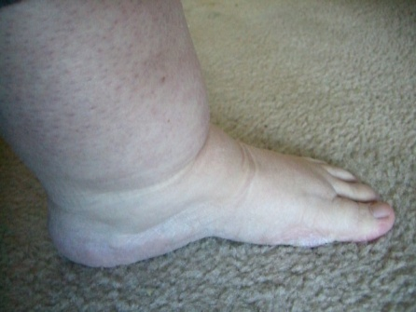
Swelling
Because the kidneys filter less, fluids build up and are dumped far away from the heart such as the ankles,
the lower part of the legs and the feet.
Diuretics are not effective because they can’t reach the swollen areas so they would cause dehydration and will just make the patient have to go to the restroom a lot.
It may be better to decrease the patient’s fluid intake.
Lotion may help a patient’s stretched skin.

Slide 10

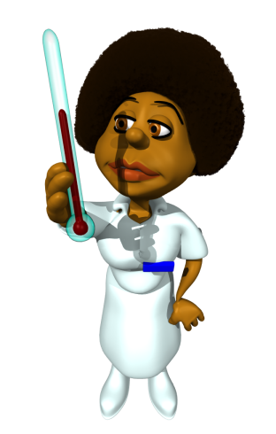
Temperature
Due to changes in the brain a patient may alternate between
Feeling hot, cold, clammy etc.
As the heartbeat becomes weaker, blood may not be pushed through the veins and arteries as efficiently as needed.
The body tries to counteract the failing circulation by pooling blood around the vital organs of the body and therefore the extremities may feel much cooler to the touch than the patient’s trunk.
Loved ones often don’t notice because if they are constantly are holding the patient's hand, it doesn’t cool off as much
as a hand that isn’t held.

Slide 11

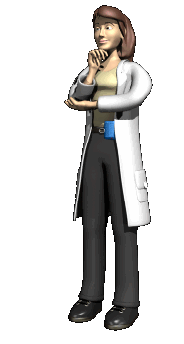

The patient’s temperature may also rise due to dehydration.
If that is the case, there is no use in giving the patient antibiotics. A cool cloth on the patient’s face, armpit, neck and groin area may help, as well as some over the counter suppositories.
Sometimes some ice cubes in a washcloth may help, but NEVER put ice
directly on a patient’s skin and NEVER hold it in just one place!
Often, covering the patient with just one sheet is enough.

Slide 12




Blood pressure decreases.
Heart rate increases – if consistently at 120 beats per minute death will likely occur within a few days to a week.
Some patients experience seizures when approaching death.
Pain management is preventative based.

Slide 13



Cheyne-Stokes breathing
Loud, deep breath – sometimes sounds like a snore
Breath with less volume
Series of even lighter ones
Breathing stops
----Sometimes 60 sec or more! ---
5. Cycle starts over.
While going through the cycle over and over, the shallow breaths will become more shallow and the periods with no breathing at all
will grow longer until the patient dies.
When the patient experiences longer periods with absence of breath watch the big blood vessel(s) in the patient’s neck.
Cheyne-Stokes breathing is not bothersome for the patient!

Slide 14
Cheyne-Stokes breathing

Slide 15

Death rattle
Labored breathing
Cough reflex is reduced
Fluids move up and down the windpipe
Does NOT bother the patient
May be very disturbing to loved ones
Suctioning is not advisable
Options
Fluids gather in the back of the throat
Patient may be too weak to cough
COMFORT
Raising the head of the bed may be beneficial to reducing death rattle as well.
Scopolamine
patch
Atropine
drops

Slide 16

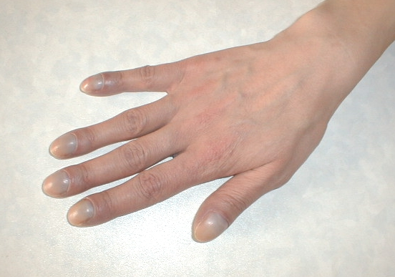

Skin color
Yellowing skin/eyes
Grey/blue skin and/or fingernails
Pale
Mottling
Heartbeat becomes weaker
Circulation is not as efficient
Patient’s blood pools in low places of the body
Along pressure points
Dark spots and/or a blotchy pattern
Often starts at the feet and “creeps up”
Overall a good indication for approaching death
Watch!

Slide 17

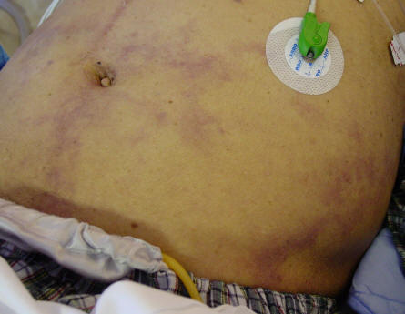
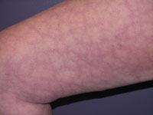
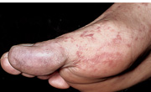
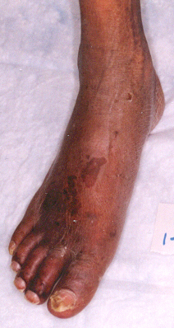
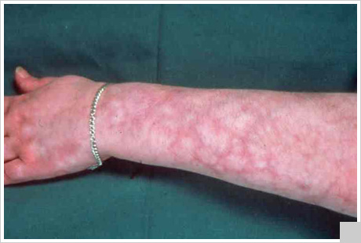
Mottling:
How does it look?
NOT GOOD!

Slide 18
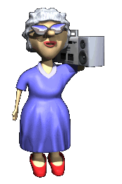

Last hoorah
Terminal agitation
renewed interest
Burst in energy level
More active and alert
Fidgeting
Restless
Unfinished business
Sometimes combative

Slide 19

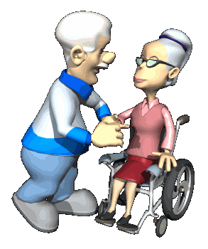
Near death awareness
Awareness of people past before
Glimpses of Heaven, Angels, animals or objects
Communicating with invisible entities
Reaching for people, animals or objects

