Slide 1

CHAPTER TWO

Slide 2

The intensity of people
Dying
is
NOT
an excuse to
be
rude!

Slide 3
It’s a tough situation for everyone
Many emotions possible
Navigate delicately
Snapshot
Lifelong habits
No judgment
Boundaries
Safety comes first!

Slide 4

Patients who are
actively dying MAY:
Be unresponsive
Experience high fevers
Need permission to die
Be waiting for somebody
Be frightened of the unknown
Struggle with unresolved Issues

Slide 5




They MAY also:
Worry what may happen to their pet(s)
Fluctuate in their level of consciousness
Worry about what will happen to their loved one(s)
Be holding on until a certain date/event has happened
Seem to be aware of entities that you may not be able to see
Seem to be communicating with these “invisible” entities
Be calm,
in acceptance
and
GOOD TO GO!

Slide 6
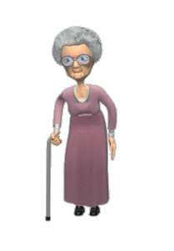
Loved ones may feel protective of the patient

Slide 7

By the time the patient is actively dying
loved ones MAY…
Cry
Be scared
Be exhausted
Feel powerless
Be hyperactive
Be profoundly sad
Struggle with guilt
Feel at the end of their rope
Struggle with family dynamics
Actually
be doing pretty good!
Be extremely passive
Struggle with anticipatory grief
Struggle with unresolved Issues
Be angry at the patient for dying
Struggle with their belief system
Struggle with the patient’s last wishes
Be struggling with unfulfilled dreams
Struggle with past experiences with death
Present with a very strong, in control front

Slide 8



Patients and/or loved ones
Patients may ask you questions about things they “see”
Am I going to die?
Does dying hurt?
Is that normal?
How long does he/she have?
Why won’t he/she eat or drink?
Will he she starve to death?
What kind of questions can you expect?

Slide 9

Is he/she in pain?
What is the nurse giving him/her?
Will that make him/her drowsy?
What happens when he/she dies?
How long will you be here?
Spiritual questions

Slide 10


Questions at facilities:
Are you a volunteer?
What do you do?
Will you turn him/change her?
What is wrong with him/her?
Why do I have to give him/her this medication?
Why do I have to take up the dosage?
Why do I have to “snow” my patient?
Is he/she in pain?
Spiritual questions

Slide 11

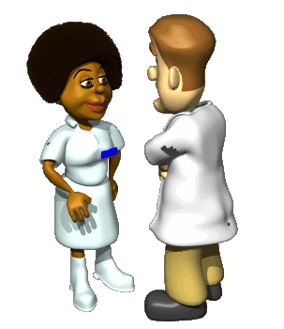
What is wrong with him?
Is she dying?
How long does he have?
Is she on hospice?
Did you contact the family?
Are they coming?
he hasn’t seen his son in years: is he coming?
What happens after she dies?

