Slide 1


Welcome

Slide 2

Gentle Pass Times
This presentation is intended as a guideline for hospice volunteers who wish to learn more about how to companion mindfully with those who are actively dying.
None of the guidelines mentioned in this presentation are hospice specific.
You are advised to follow the rules and regulations of the hospice that you
are volunteering for.

Slide 3
Gentle Pass Times
A transition volunteer training

Slide 4

CHAPTER ONE

Slide 5



Topics shared today
What is transition care?
What to bring/What to know
Introductions/Working with staff members
The intensity of people
What kind of questions can you expect?
The signs & symptoms of dying

Slide 6
Topics shared today
What can you do for a patient?
What can you do for loved ones?
Children and pets
Restless patients
What NOT to do
When the patient dies
The importance of self care

Slide 7

What is transition care?
Support at the END of life
Patient is often unresponsive
Patient may die within hours to days
Patient may die while you are present
Support for the patient
Support for loved ones
Many emotions may be involved
You are the eyes and ears for hospice
A trifecta of gifts!

Slide 8







What to bring
Bring an open heart!
Notepad and pen
Disinfectant
Be dressed properly/Badge
Patient’s information
Appropriate phone numbers
Bottle of water

Slide 9






A Book
A stuffed animal
Soothing music
Wear a watch

Slide 10



General knowledge
Boundaries!
Hospice protocol
The process of dying
Basic familiarity with medications commonly used at the end of life
What type of residence, after hours access
In case of a facility – name, full address and phone number
Where to park, parking meters

Slide 11



Patient specific information:
Special considerations
Who is on call after hours
Who is on the patient’s care team
Family dynamics
Children and pets
Some of the patient’s history
Patient’s diagnosis, status, gender and age
Patient’s full name, phone number and address

Slide 12
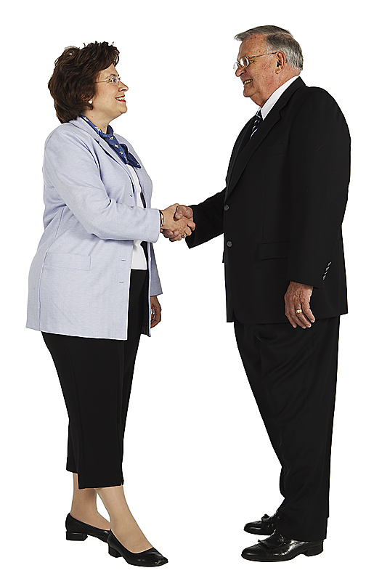
Introductions

Slide 13

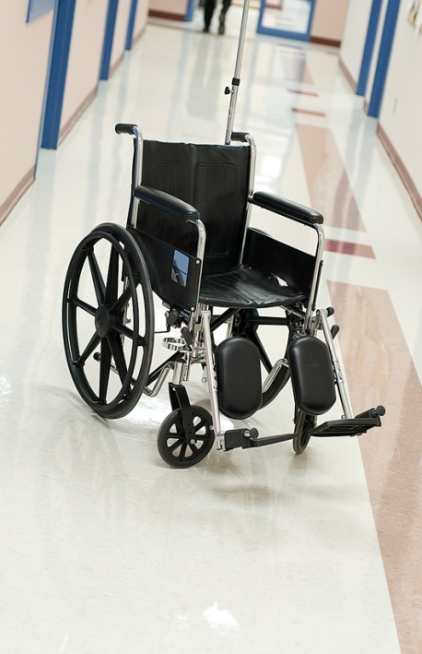


At a facility:
Reception desk/guestbook
Emergency exits
Nurses’ station

Slide 14


Meeting the patient and/or loved ones:
Badge
Disinfect
Be in patient’s field of vision
Do not tower over a patient
Address the patient appropriately
Short, clear sentences
Introducing on a personal level
Write down your name
Ask questions
Be responsible for the energy that you bring!

Slide 15

Physical Introduction
May be implemented with patients who are unconscious/unresponsive
May make the patient physically aware of your presence
May be comforting to loved ones

Slide 16





Working with staff members
Introduce yourself to patient’s care team
Explain how long you will be there
Explain your scope as a volunteer

Slide 17


Working with staff members
Be respectful and show tact
Do not make assumptions
Call button
If you think that the patient needs something, explain why
Offer staff members “alone time” with the patient
Keep staff members updated
Thank staff members after your shift ends

